Slide 1





Organic waste management by a small-scale innovative automated system of anaerobic digestion
Supported by the European Commission
under the research for SME associations theme
of the 7th Framework Programme for Research and
Technological Development
1st August 2012 to 31st July 2015

Slide 2

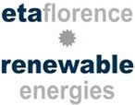

















Consortium

Slide 3
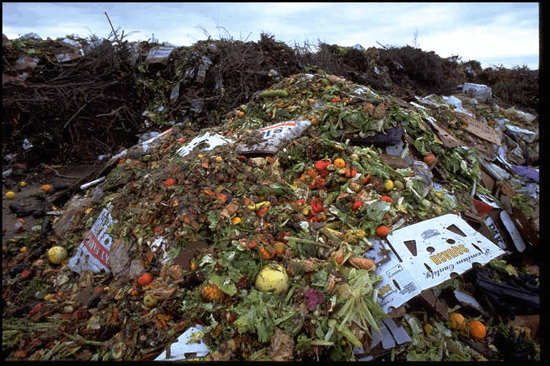
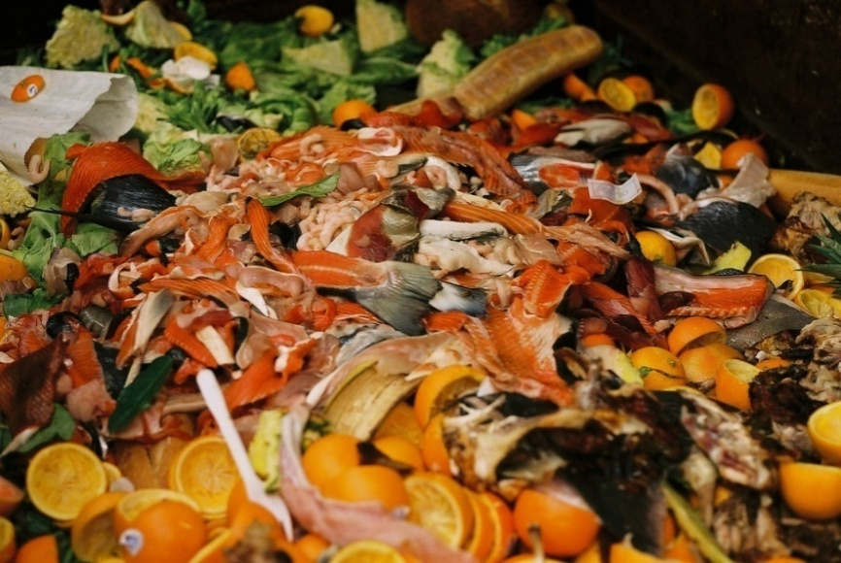
Background
SME agro-food industries have to manage large quantities of organic waste – over 239 million tonnes.
  Space issues (no place for long term storage)
  Hygiene issues include nauseous odours and microorganism proliferation
  There is also the negative impact on the global environment quality which includes generation of greenhouse gases and uncontrolled emission of dioxins.

Slide 4
EU Policy environment
Landfill Directive (1999/31/EC)
  Landfill diversion targets for biodegradable waste
  compared to 1995: 35% by 2016 (for some countries by 2020)
  Municipal waste: 50% minimum recycling by 2020
  MS shall take measures to encourage (art. 22) :
    separate collection of bio-waste with a view to the composting and digestion;
    use of environmentally safe materials produced from bio-waste;
    environmental friendly treatment of bio-waste

Slide 5
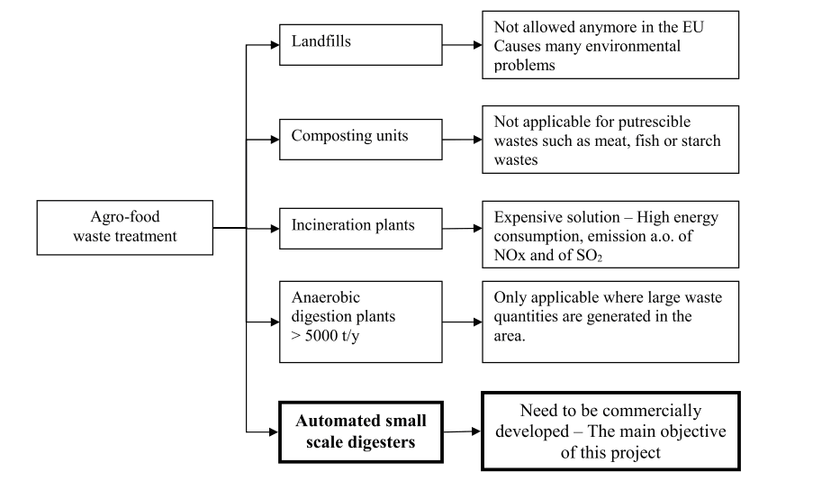

Treatment options
X
X
X
X

Slide 6
Anaerobic digestion
Anaerobic digestion is a multi step process (including hydrolysis, acidogenic, acetogenic and methanogenic phases) by which different bacteria and archaea can break down a biodegradable substrate in the absence of oxygen.
This process produces:
  A “biogas” which can be used as fuel thanks to its high methane content (60 to 80%). This biogas also includes carbon dioxide and traces of hydrogen sulphide, ammonia, water vapour, other organic volatiles and nitrogen gas;
  A nutrient-rich digestate which can be used as fertilizer.
It occurs in multiple environments including digestive systems, marshes, rubbish dumps, septic tanks etc. Humans have managed to transfer the activity occurring in the environment to engineered sealed controlled vessels of various designs called digesters.

Slide 7
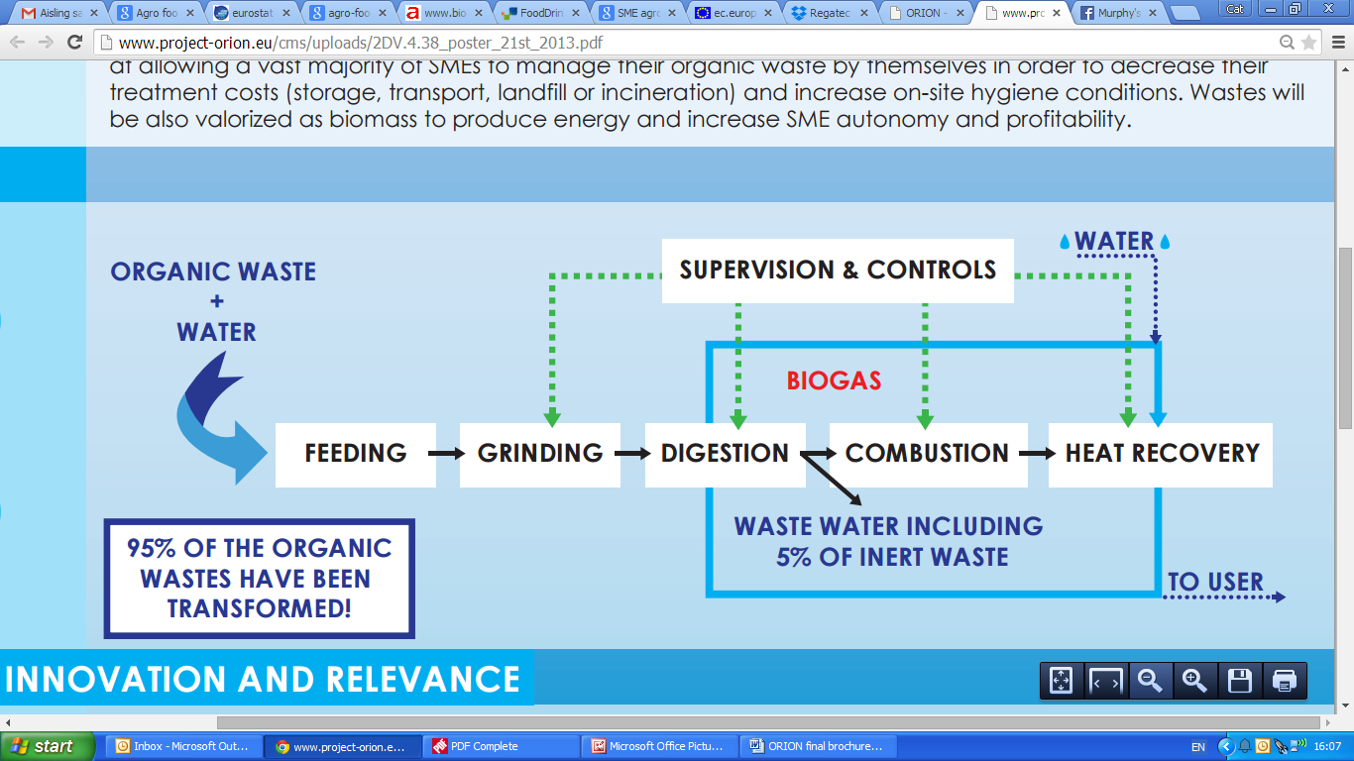
ORION solution
Orion is a unique SME scale (3000L) anaerobic digestion machine.
It can process a large range of organic inputs.
Advanced control tools and sensors ensure an optimum reliability meaning low operational costs.
Availability of big quantities of waste and controlled transport costs ensure economic viability

Slide 8
ORION solution – feeding
Suitable inputs: organic waste from: |  | WASTES – EXAMPLES
Agro-food |  | Cheese whey | 297 NLCH4/kgVS
Aquaculture |  | Salmon waste | 408-525 NLCH4/kgVS
 |  | Seaweed | 149 NLCH4/kgVS
HORECA |  | Restaurant waste | 560 NLCH4/kgVS
 |  | Food&vegetable | 399 NLCH4/kgVS
Orion can process 25 – 250 kg/day of dry matter, corresponding more or less to 80 – 1000 kg/day of fresh waste (depending on digester dimension, composition and water content of the waste).
Waste streams ≤ 5,000 t/y.
The composition and characteristics of biogas are highly dependent on the different organic waste sources (produced quantities, physico-chemical and biochemical parameters). Co-substrate may be necessary in order to optimize the AD process.
The control tools maximize the stability of the digestor.

Slide 9
ORION solution – grinding
The grinder reduces the organic matter to be digested to small particles (2-3 mm) and mix it in order to facilitate the break down of the biodegradable substrate by microorganisms.
The grinding process of the waste is automatically controlled.
The PLC controls the moment to pump it to the digestion module.

Slide 10
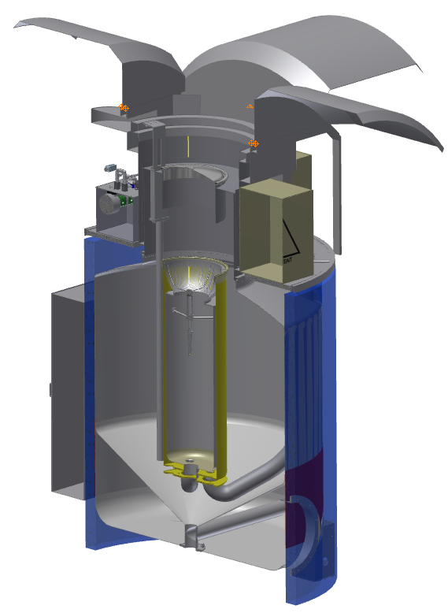
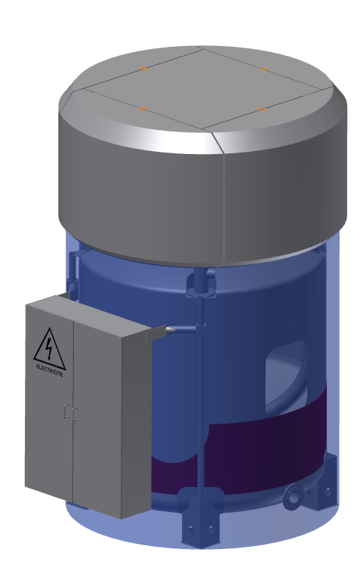
ORION solution – digestion module
Total digester volumes: between 3 and 30 m³
2-3 digesters can be mounted in parallel to reach a higher capacity if needed.
The digestion module is composed of two distinct parts.
The head collects the biogas produced in a gasholder and contains operation and measurement equipment.
The body is where the biological process of biomethanation occurs.
Digesto concept (Patent demand PCT/IB2013/056263)

Slide 11
ORION solution – energy
management module
The energy management system is responsible for :
biogas valorisation
heating of the biological process
Small, certified biogas boiler, heat exchanger for hot water bath

Slide 12
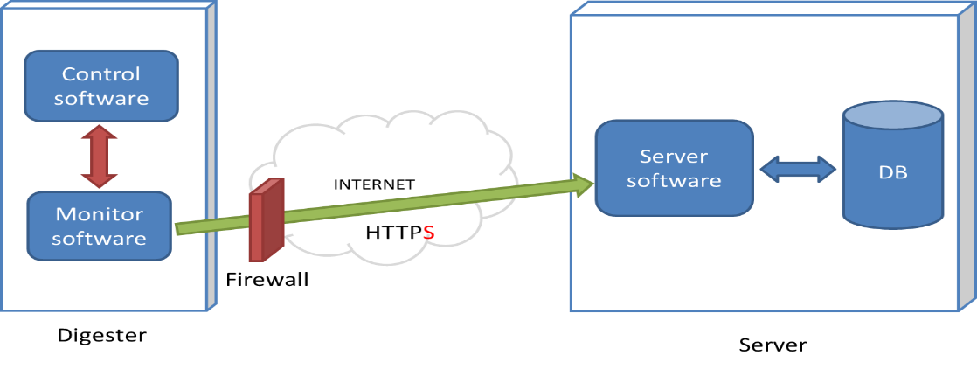
ORION solution – control
Remote monitoring and storage of more than 80 process and component status variables: digester performances optimization and for breakdown prevention
Fuzzy logic controller for proactive process control based on automated measurements

Slide 13
ORION solution – control
The only end-user interface is with a convenient waste grinder.
Indicators of grinder operation and manual operation interface

Slide 14
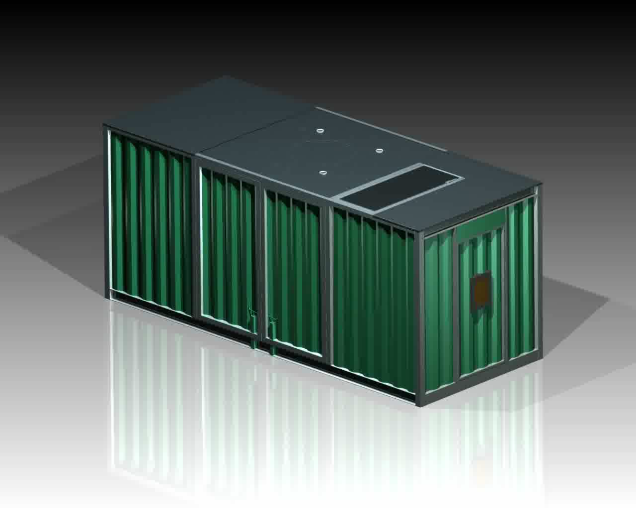
ORION solution – configuration
Transportability
Every module inside the container
Simple deployment, easy to assemble
Accessibility
Maintenance
BOILER
BOILER
DIGESTER
GRINDER
DIGESTER
GRINDER

Slide 15
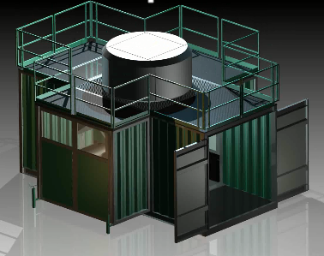
ORION solution – configuration
Deployed ORION digestion station on end-user site

Slide 16
Benefits
Reduced cost for waste treatment
No transport of waste
Recycling of energy from organic wastes
Enclosed process – low emissions
Reduced risks regarding food hygiene
Technology complies with EU and national legislation

Slide 17
Benefits
Reduction in greenhouse gas emissions in comparison to landfill
Commercialisation of ORION system
Compost from digester can be used
Mobile machine

Slide 18
Thank you for your kind attention!
Julie Maguire
DOMMRS
julie.maguire@dommrc.com

