Slide 1





Organic waste management by a small-scale innovative automated system of anaerobic digestion
Supported by the European Commission
under the research for SME associations theme
of the 7th Framework Programme for Research and
Technological Development
1st August 2012 to 31st July 2015

Slide 2
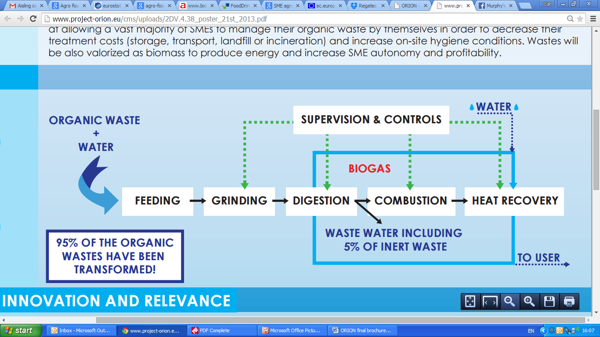
Digestion Module
The organic matter is subjected to pretreatment such as grinding before entering the digestion module.
The digestion module is where the digestion process occurs, resulting in biogas production.
The digestion module design is conceived in a way to maximize the methane content in the biogas and to ensure an optimal reliability.

Slide 3
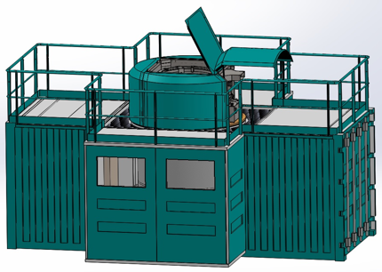
Digestion Module
Digestion module
Deployed ORION digestion station on end-user site

Slide 4
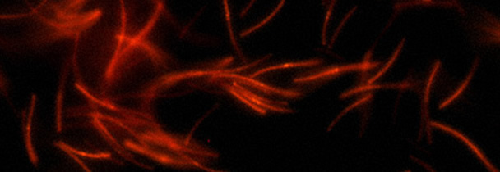
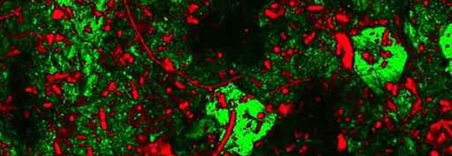
Anaerobic digestion in a nutshell
Anaerobic digestion is a multi step process by which different bacteria and archaea can break down a biodegradable substrate in the absence of oxygen.
This multi step process, where the product of one stage becomes the substrate for the next step, produces biogas.
The remaining, indigestible material the microbes cannot use and any dead bacterial remains constitute the digestate.

Slide 5
Anaerobic digestion – step 1
Hydrolysis
The incoming substrate is built of carbohydrates, proteins and fats which are not water-soluble.
These undissolved compounds are broken down into water-soluble fragments (monomers) by exoenzymes produced by bacteria.
A large and diverse group of bacteria is needed for this process.
The products of this stage are simple sugars, fatty acids and amino acids
Complex organic matter
Carobhydrates, proteins, fats
Hydrolysis
Soluble organic molecules
Sugars, amino acids, fatty acids

Slide 6
Anaerobic digestion – step 2, 3
Acidogenesis (acid formation)
The monomers that were the products of the hydrolytic phase are taken up by the bacteria and further degraded into short-chain organic acids, alcohols, hydrogen and carbon dioxide.
Acetogenesis (acetate formation)
These simpler molecules are utilised by “acetogenic” bacteria to produce acetic acid, with carbon dioxide as another product of the breakdown.
The product of the acetogenic phase is acetate. Acetate is important because it is the primary substrate used by methanogenic bacteria.
Complex organic matter
Carobhydrates, proteins, fats
Hydrolysis
Acidogenesis
Acetogenesis
Soluble organic molecules
Sugars, amino acids, fatty acids
Volatile fatty acids
Acetic acid
H2 + CO2

Slide 7
Anaerobic digestion – step 4
Methanogenic phase (methane formation)
A group of archaea is responsible for the methanogenic phase.
Methanogens are able to use the acetic acid and produce methane.
There is also another group of methanogens that convert hydrogen and carbon dioxide to methane. In this step the archaea methanogens form methane using mostly acetate, CO2 and H2.
Methane can also be formed from some other organic compounds but all compounds that are not degraded by the methanogens will accumulate in the digester.
Complex organic matter
Carobhydrates, proteins, fats
Hydrolysis
Acidogenesis
Acetogenesis
Methanogenesis
Soluble organic molecules
Sugars, amino acids, fatty acids
Volatile fatty acids
Acetic acid
H2 + CO2
CH4 + CO2

Slide 8
Anaerobic digestion - temperature
There are also some bacteria that compete with the productive bacteria. One kind of such bacteria are sulphate-reducing bacteria that also uses acetate, hydrogen and carbon dioxide (like the methanogens) but instead produces hydrogen sulphide. There are different temperatures that are optimal for different species and there are also some substances that are toxic/inhibitory for some species.
The two conventional operational temperature levels for anaerobic digesters determine the species of methanogens in the digesters:
  Mesophilic digestion takes place optimally around 30 to 38 °C, or at ambient temperatures between 20 and 45 °C, where mesophiles are the primary microorganism present.
  Thermophilic digestion takes place optimally around 49 to 57 °C, or at elevated temperatures up to 70 °C, where thermophiles are the primary microorganisms present.

Slide 9
Anaerobic digestion - complexity
Competing needs:
Single-stage digestion system (one-stage): all of the biological reactions occur within a single, sealed reactor or holding tank.
The biological reactions of the different species in a single-stage reactor can be in direct competition with each other!!
Two-stage digestion system (multistage): different digestion vessels are optimised to bring maximum control over the bacterial communities living within the digesters.
Reduced construction costs
High control of the reactions

Slide 10
Digestion module - grinding
The user puts the organic matter in the feeding hopper of the grinder and presses the botton “grinding”.
A grinding cycle can be started as soon as the feeding hopper is full (daily, twice a day).
When functioning, the door of the grinder is blocked. In case of problem with the grinding (unwanted materials, mechanical problem, etc.), a alarm will warn user/maintenance operator and stop the system to prevent further damages.
The grinder reduces the organic matter to be digested to small particle (2-3 mm) and mix it in order to facilitate the break down of the biodegradable substrate by microorganisms and mixes them.
The PLC controls the moment to pump it to the jabot of the digestion module.
An automatic periodic self-cleaning cycle is provided to pump the ground organic matter from the jabot to the digestion module.
The grinding unit can be located in the container (door towards the outside) or directly where the waste is produced (i.e. kitchen). This last solution is the most convenient for the end-user but needs a pipework to transport the grinded matter to the digestion module.

Slide 11
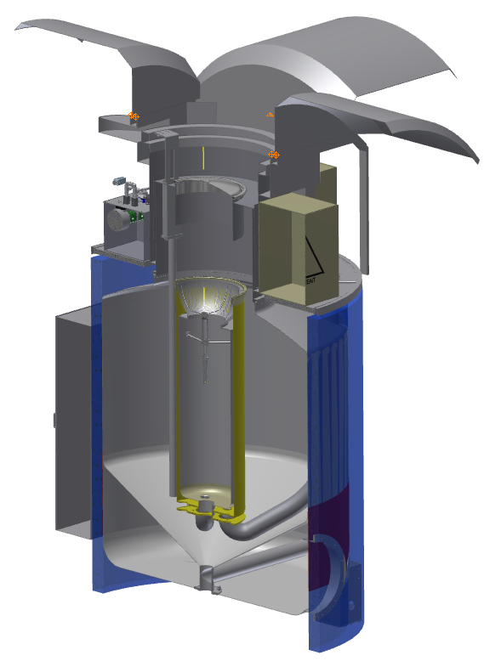
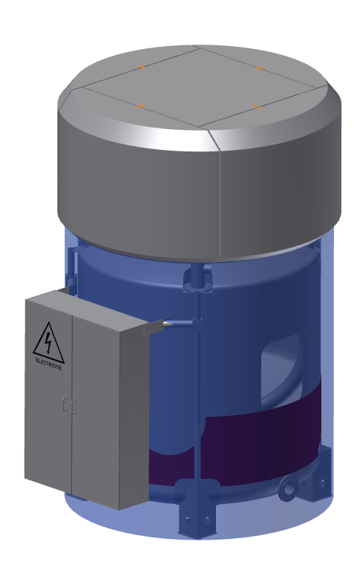
Digestion module - components
Total digester volumes: between 3 and 30 m³
The digestion module consists in a methanation tank, fitted with a central jabot and topped by a rotating, floating gasholder linked with the agitation system.
The head collects the biogas produced in a gasholder and contains operation and measurement equipment.
The body is where the biological process of biomethanation occurs.
Digesto concept (Patent demand PCT/IB2013/056263)

Slide 12
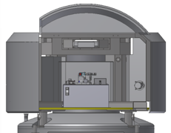
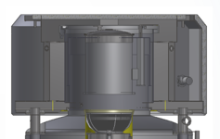
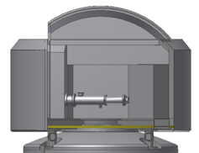
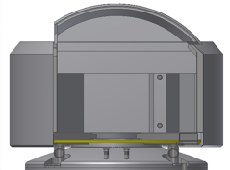
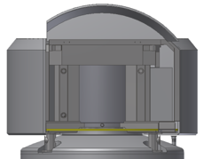
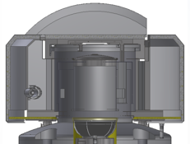
Digestion module - head
4 lateral covers of the head where connected devices can be placed. The lateral compartments are dedicated to 4 sub-systems: Hydraulic, Biomass, Biogas, Nose & Tongue.
Hydraulic unit
Central cover of the head housing a mobile, floating and rotating gasholder, linked with the agitation system, responsible for collecting the biogas produced and connected to the gas utilization unit (peripheral). The central compartment gives access to: Tank, Mixing system of the tank, Jabot, Gasometer
Biomass compartment
Biogas compartment
Control
Panel
The 5 parts of the head can be individually opened for control/maintenance operations.
Nose and tongue compartment

Slide 13
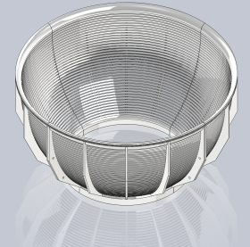
Digestion module - body
Sieving grid
Filters the overflow.
Jabot
Feeds the methanation tank regularly.
Initiates first step of the digestion.
Methanation tank
Biogas production from methanogenic process.
Hot water bath

Slide 14
Digestion module - functioning
The jabot receives the matter to be digested from the grinder and releases it into the methanation tank at short and regular intervals (which may be regulated, e.g. 10 – 30 min). It may also initiate the first steps of the digestion process.
The sheath surrounding the jabot collects the overflow of the liquid fraction of the digestate that has passed through the sieving grid.
The methanation tank, surrounding the jabot, is where the biological methanogenic process leading to biogas production occurs (infinitely stirred process with suspended biomass).
The sieving grid filters the overflow from the methanogenic tank and retains particles of insoluble matter which cannot pass through the grid, thus allowing them to fall back to the jabot and returning at the beginning of the digestion process. The liquid fraction of the overflow going through the sieving grid is the liquid effluent, which is eliminated.
The digester is heated and continuously kept at a constant temperature to ensure an optimal biomethanation process. It can be programmed for mesophilic or thermophilic process.

Slide 15
Digestion module – circulation and mixing
The circulation and mixing system is entirely internal to the digestion module.
It is operated by a 4-ways distributor coupled with a bi-directional volumetric pump, controlled by the PLC.
The hydraulic system is responsible for substrate and co-substrate (optional) distribution and mixing.
Mixing of the methanation tank content can be achieved by:
    Mechanical agitation (adjustable rotary blades)
    Biogas re-circulation (through bubbling plate)
    Substrate re-circulation.
Mixing of the jabot content can be achieved by:
    Substrate re-circulation
    Biogas re-circulation (optional).

Slide 16
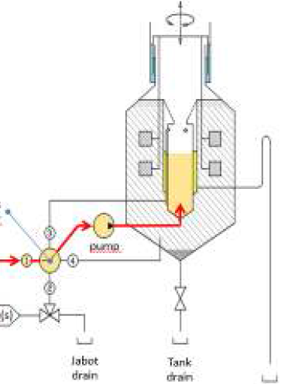
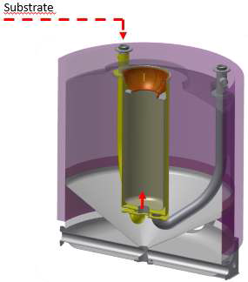
Digestion module – circulation and mixing
The 4-ways distributor defines a 4-position switch, corresponding to:
Position 1: Substrate loading from the grinder (or buffer tank) into the jabot
Substrate
4 ways distributor
pump
Substrate
Co-Substrate(s)
Jabot drain
Tank drain
Liquid
fraction outflow

Slide 17
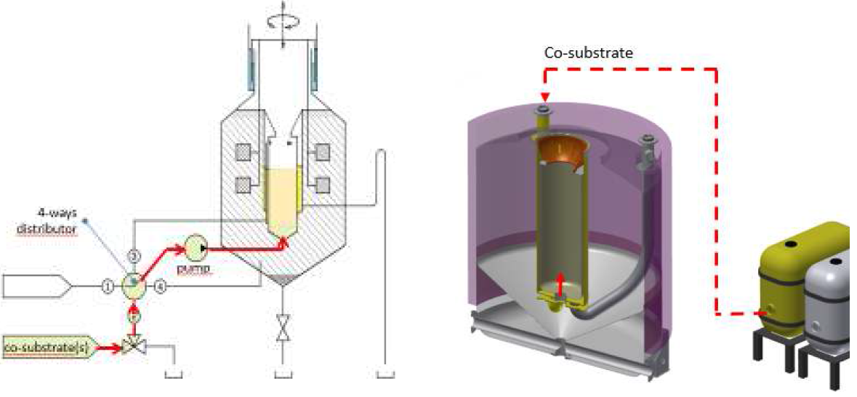
Digestion module – circulation and mixing
The 4-ways distributor defines a 4-position switch, corresponding to:
Position 2: co-substrate loading (optional) to the jabot
Co-Substrate
4 ways distributor
pump
Co-Substrate(s)

Slide 18
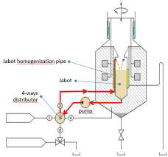
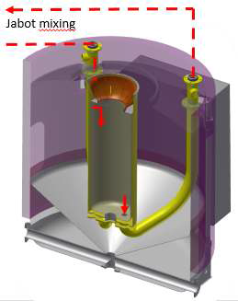
Digestion module – circulation and mixing
The 4-ways distributor defines a 4-position switch, corresponding to:
Position 3: mixing and homogenisation of the jabot content
Jabot mixing
Jabot homogenization pipe
Jabot
4 ways distributor
pump

Slide 19
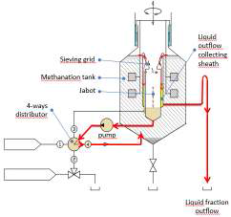
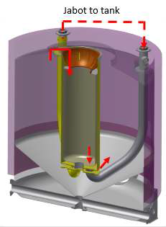
Digestion module – circulation and mixing
The 4-ways distributor defines a 4-position switch, corresponding to:
Position 4: introduction of the jabot content into the methanation tank
Liquid outflow collecting sheath
Jabot to tank
Sieving grid
Methanantion tank
Jabot
4 ways distributor
pump
Liquid fraction outflow

Slide 20
Digestion module – cleaning and draining
Different parts of the digestion module need to be regularly cleaned to ensure their optimal functioning.
The self-cleaning device for the grinder uses hot water to clean the grinder after each cycle of grinding. If necessary, soapy water can also be used, but in that case the effluent is sent to sewage.
The self-cleaning device for the sieving grid ensures that the grid does not get blocked as its role is to filter the methanation tank overflow and to retain particles in the jabot.
The sieving grid can also be easily changed when necessary.
The self-cleaning device for the gasholder is an access to make it possible to easily clean the device if necessary.

Slide 21
Digestion module – cleaning and draining
When necessary, floating or sedimented materials that cannot be digested can be removed from the digestion module.
Floating inert materials accumulated in the methanation tank can be removed to the jabot by overflow. If these materials are not degraded and accumulate in the biological system, they can be pumped out the jabot through the 4-ways distributor in position 2.
Inert and heavy materials (e.g. sand) sedimented in the bottom of the methanation tank are drained out through drain (to sewage). The same path can be used to empty the whole methanation tank if necessary (process failure).

Slide 22
Digestion module – connecting networks
The connecting networks requirements are:
Electricity
Power requirement: 1 plug CEE, 400 V, 32 A.
Water
Water supply: connection to tap water.
Sewage connection: for digested liquid fraction going through the sieving grid.
Solids extraction: 1 tank > 3m³ (also to empty the digester if needed).
Gas
Internet
Internet connection with a good bandwidth. Through a delivered Internet switch, different components will be connected:
  A PC with the development tool (giving access to the low level panels).
  The PLC.
  A webcam.
The digestion module is conceived as a machine that includes all the connecting to the devices necessary to its functioning, apart from some peripheral devices (grinding unit, combustion module, buffer tanks).

Slide 23
Digestion module – control
Programmable logic controller for distance monitoring of the digester performances and for breakdown prevention
The only end-user interface is with a the waste grinder
On-line VFA measurements inform the controller and allow precise control of feeding

Slide 24
Digestion module – innovative aspects
The ORION process combines advantages of one-phase and of two-phase digesters, both vessels working under a common gas phase.
Uncoupled solid and liquid retention times made possible by the use of an internal «jabot» and sieve
Intelligent selection of surface materials to promote or to inhibit biofilm growth
The microorganisms in the methanation tank combine H2 (eventually produced in the jabot in significant amounts) with CO2 to synthesize methane. In this way H2 concentration is kept very low, avoiding explosion risks and losses.
Liquid and gas phase sensors of conventional parameters including H2 and Volatile Fatty Acids

Slide 25
Digestion module – performance
Conventional indicators of anaerobic digestion performance
Indicator | Units | Remark
Organic loading rate | Kg VS or COD.m⁻³ digester.day⁻¹ | Determines tank volume
Hydraulic retention time | Days | Determines tank volume
Biogas yield | m³ Biogas.kg⁻¹ VS or COD loaded | Effectiveness of the digester configuration and of the bacteria
Volumetric productivity | m³ biogas.m⁻³ digester.day⁻¹ | Used to compare to other digesters
Methane content of biogas | % volume | Depends on substrate, digester configuration and microbiology
Volatile solids removal | % of loaded volatile solids | Effectiveness in removal of the biodegradable fraction of wastes
COD removal | % of loaded COD | Effectiveness in removal of the biodegradable fraction of wastes

Slide 26
Digestion module – performance
Digestion module – performance
Possible performance indicators from the end user’s point of view
Indicator | Units | Remark
Waste treatment capacity | kg wet wastes.m⁻³ digester.day⁻¹ | Including washing water
Space requirements | m² floor space.kg⁻¹ wet waste.day⁻¹ | The grinder and the digester can be placed in separate locations
Availability | % of business hours with unrestricted use | The user must be able to eliminate wastes at any time during business hours
Methane yield | m³ CH₄.kg⁻¹ wet waste loaded | Needed to estimate the energy production
Thermal energy production | kW thermal power | Heat available to the user after satisfying the digester’s requirements
Effluent total solids | g.l⁻¹ | To be compared to local discharge limits
Effluent COD | g.l⁻¹ | To be compared to local discharge limits
Effluent NH₄⁺ | mg.l⁻¹ | To be compared to local discharge limits
Effluent PO₄³⁻ | mg.l⁻¹ | To be compared to local discharge limits
Effluent flow rate | l.day⁻¹ | Needed to determine wastewater discharge fees
Gaseous emissions | ppm SO₂, ppm CO | To be compared to local emissions limits

Slide 27
Digestion module – results
Results from bench-scale and pilot testing of restaurant wastes
Indicator | Units | Bench-scale (20 liters) | Pilot-scale (650 liters)
Organic loading rate | kg VS.m⁻³ digester.day⁻¹ | Up to 5,5 kg VS | 1,3 to 3 kg VS
Hydraulic retention time | Days | 17.5 to 30 | 20 to 38
Biogas yield | m³ biogas.kg⁻¹ VS loaded | 0.5 to 1.3 | 0.6 to 1
Volumetric productivity | m³ biogas.m⁻³ digester.day⁻¹ | 1 to 7 | 0.8 to 2.2
Methane content of biogas | % volume | 52 to 72% | 50 to 64%
Volatile solids removal | % of loaded volatile solids | Up to 75% | 92%

Slide 28
Digestion module – results
Results from bench-scale and pilot testing of restaurant wastes
Indicator | Units | Bench-scale (20 liters) | Pilot-scale (650 liters)
Waste treatment capacity | kg wet wastes.m⁻³ digester.day⁻¹ | 75 | 50
Space requirements | m² floor space.100 kg⁻¹ wet waste.day⁻¹ | n.a. | 68
Availability | % of business hours with unrestricted use | n.a. | 90
Methane yield | m³ CH₄.kg⁻¹ wet waste loaded | 0.5 | 0.18 to 0.46
Thermal energy production | Watts thermal power equivalent | 12 | 200
Effluent total solids | g.l⁻¹ | 30-100 | 3 to 12
Effluent COD | g.l⁻¹ | Not measured | 5 to 20
Effluent NH4+ | mg.l⁻¹ | 800 to 2000 | 350 to 2200
Effluent PO43- | mg.l⁻¹ | Not measured | Not measured
Effluent flow rate | l.day⁻¹ | Up to 2 | up to 30
Gaseous emissions | ppm SO₂, ppm CO | Not measured | Not measured
Solid emissions | kg wet inorganics (sand) every 2 weeks | Not Measured | 2

Slide 29
Digestion module – results
20 liter bench-scale system
More than 12 months experience testing anaerobic digestion of restaurant wastes, fruits and vegetables, wastes from fruit and fish processors, waste paper and dewatered municipal sludge co-substrates. The configuration includes a biofilm deposition and recirculation cell.
Results presented in the poster session of the EUBC&E 2015, Vienna: “SME-targeted anaerobic digesters for on-site waste management Microbiological and physicochemical characterization at 20 L scale with different organic wastes”
650 liter pilot system
More than 12 months continuous, stable operation using restaurant wastes and sometimes a waste paper co-substrate. The main objectives were to develop and test the jabot, sieve, liquid and gas sensors, HMI, automation and data logging.
Results will be published in late 2015

Slide 30
Thank you for the attention!
May you have any questions, please contact:
mark.mccormick@heig-vd.ch
jean-bernard.michel@heig-vd.ch

